Slide 1

ACT-W: Advancing The Careers of Technical Women
August 5 2017
Austin TX

Slide 2
Cloudy with a chance of Application
Shawn Weisfeld

Slide 3








About Me
Shawn Weisfeld
Cloud Solution Architect
Microsoft – One Commercial Partner Technical Team
sweisfel@microsoft.com
Austin, TX

Slide 4


Watch User Group presentations for FREE online! We now have over 625 presentations online
Miss a User Group meeting?
Forget something that you learned?
Want to see content from a User Group not in your area?
Want to share with a buddy?
Presentations from the thought leaders on the topics you care about including:
Agile
Azure
C#
Entity Framework
HTML5
MVC
SQL
jQuery
and Much More!
We know you cannot make it to every session,
that is why we post them online for you!
New Content added all the time!
For new content announcements
@UserGroupTV
http://www.UserGroup.tv

Slide 5

What is Cloud Computing?
Essential Characteristics:
On-demand self-service.
Broad network access.
Resource pooling.
Rapid elasticity.
Measured service.
Service Models:
Software as a Service (SaaS).
Platform as a Service (PaaS).
Infrastructure as a Service (IaaS).
Source: http://nvlpubs.nist.gov/nistpubs/Legacy/SP/nistspecialpublication800-145.pdf

Slide 6
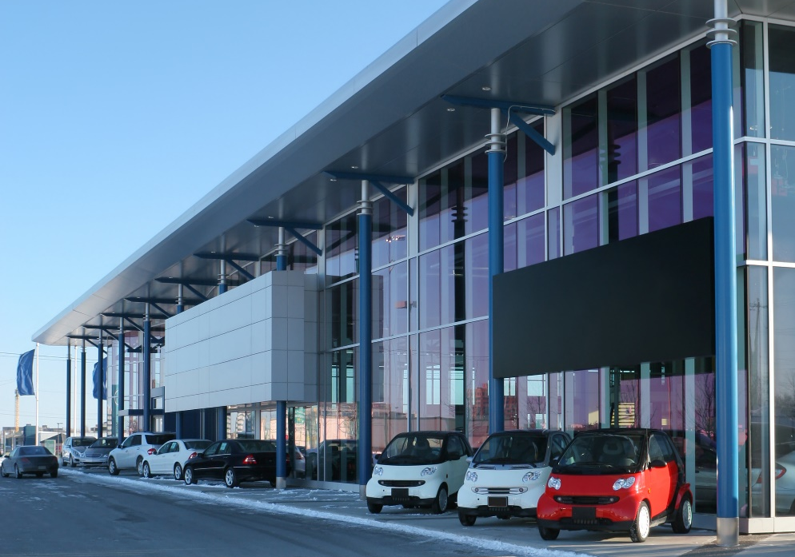


Let’s say your app is a car…
IaaS
PaaS
SaaS
…you can own and operate your own car
…you can rent a car
…you can take a taxi
Cut to the code - create innovative apps using an application platform

Slide 7























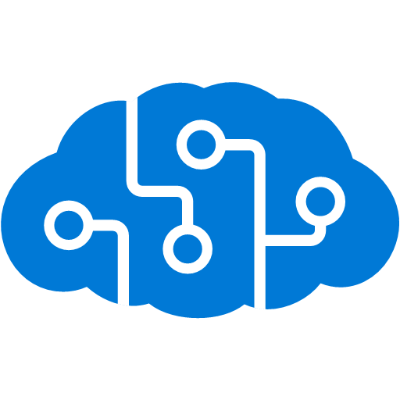







































Platform Services
Security & Management
Hybrid
Cloud
Media & CDN
Application Platform
Data
Security Center
SQL
Database
Azure AD
Health Monitoring
Media Services
Media Analytics
Content Delivery
Network
Web
Apps
Mobile
Apps
SQL Data
Warehouse
CosmosDB
Portal
AD Privileged
Identity
Management
Azure Active
Directory
Integration
SQL Server
Stretch Database
Redis
Cache
Storage
Tables
Azure
Search
API
Apps
Cloud
Services
Azure AD
B2C
API
Management
BizTalk
Services
Domain Services
Service
Fabric
Notification
Hubs
Intelligence
Multi-Factor
Authentication
Logic
Apps
Service Bus
Functions
Cognitive Services
Bot Framework
Cortana
Backup
Automation
Developer Services
Analytics & IoT
Operational
Analytics
Compute Services
Scheduler
HDInsight
Machine
Learning
Stream Analytics
Container
Service
VM
Scale Sets
Visual Studio
Mobile
Engagement
Import/Export
Key Vault
Data
Catalog
Data Lake
Analytics Service
Data Lake Store
Store/
Marketplace
Batch
RemoteApp
VS Team Services
Xamarin
Azure Site
Recovery
Application
Insights
HockeyApp
IoT Hub
Event
Hubs
Data
Factory
Power BI
Embedded
Dev/Test Lab
StorSimple
Infrastructure Services
Compute
Storage
Networking
Virtual Machines
Containers
Blob
Queues
Files
Disks
Virtual Network
Load Balancer
DNS
Express
Route
Traffic Manager
VPN Gateway
App
Gateway
Datacenter Infrastructure

Slide 8
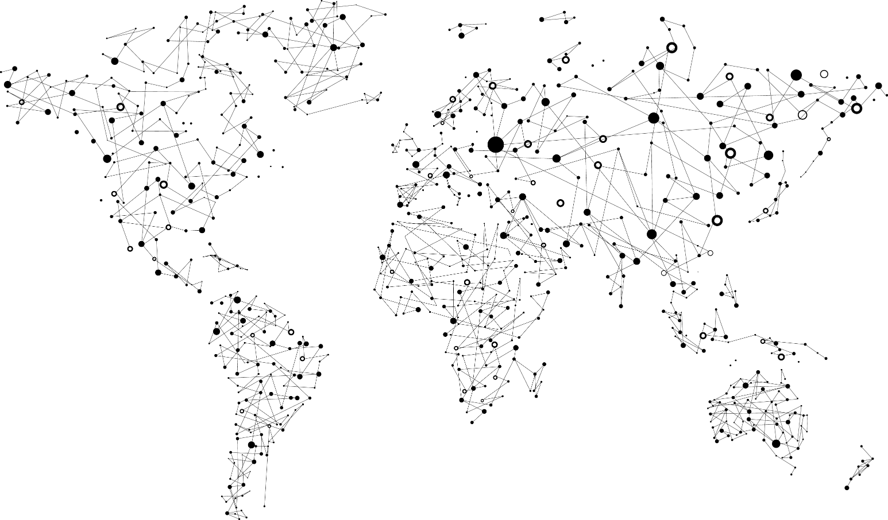
Achieve global scale, in local regions
40
Azure regions
including
Azure Commercial
& 3 National Clouds
US Government
Germany
China

Slide 9
Hands on Lab

Slide 10
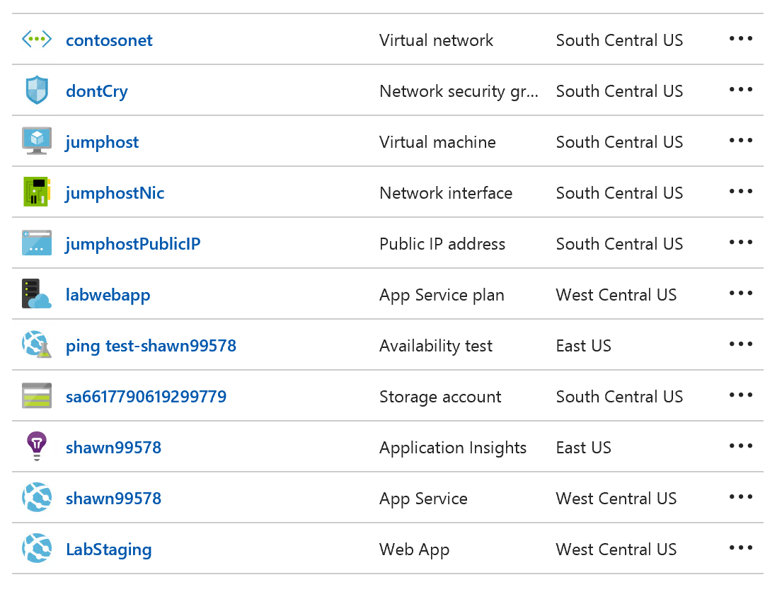
What we are going to do
Create an IaaS Virtual machine that we are going to use as a dev box
Create and Configure two PaaS Services
App Service Web Site
Application Insights

Slide 11
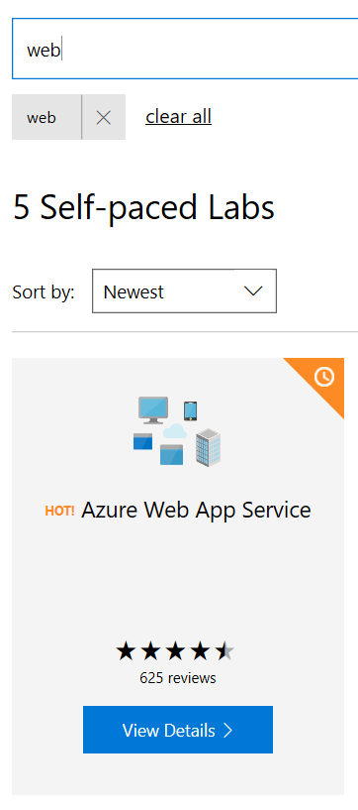
Hands on Lab Instructions
Go To: https://www.microsoft.com/handsonlabs/SelfPacedLabs
Search for “web”
Select the “Azure Web App Service” Lab

Slide 12
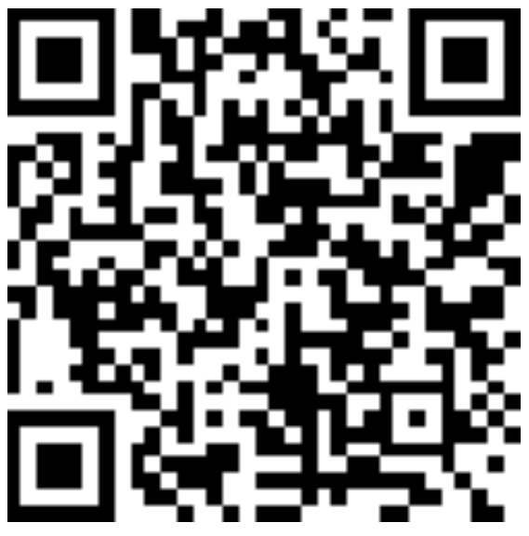
Thank you! Your Feedback is Important
Rate My Talk & Download Slides!
http://bit.ly/RateShawnsTalk
(case sensitive)
Contact Information
Email: sweisfel@microsoft.com
Blog: http://www.shawnweisfeld.com
Twitter: @shawnweisfeld

